Slide 1
Lead Score Assignment
Anuj Sharma
Gurveen Gill
Shaktiprasanna
DS C47
Upgrad & IIITB | Data Science Program
28th February 2023

Slide 2
Agenda
01. Problem Statement & Goal
02. Methodology
03. Exploratory Data Analysis
04. Model Training and Assessment
05. Summary

Slide 3
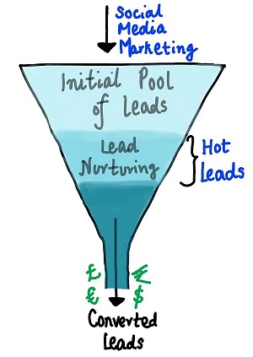
A. Problem Statement
X Education sells online courses to industry professionals and gets a lot of leads on its website every day.
The company wishes to identify the most potential leads, known as 'Hot Leads', to increase its poor lead conversion rate of around 30%.
A lead conversion process can be represented using a funnel, where many leads are generated initially, but only a few become paying customers.
X Education needs a model to assign a lead score to each lead to identify the customers with a higher conversion chance.
The target lead conversion rate is around 80%.

Slide 4

A. GOAL
Develop a logistic regression model to assign lead scores between 0 and 100
Use lead scores to target potential leads, with higher scores indicating hotter leads more likely to convert and lower scores indicating colder leads less likely to convert
Account for additional problems presented by the company that the model should be able to adjust to in the future
Fill out the separate document based on the logistic regression model from step one
Include all findings and recommendations in the final PowerPoint presentation

Slide 5
B. Methodology
Data Sourcing
Data Clean up and Preparation
Feature Engineering
Exploratory Data Analysis
Model Training & Evaluation
Model Assessment
Inference/Summary

Slide 6
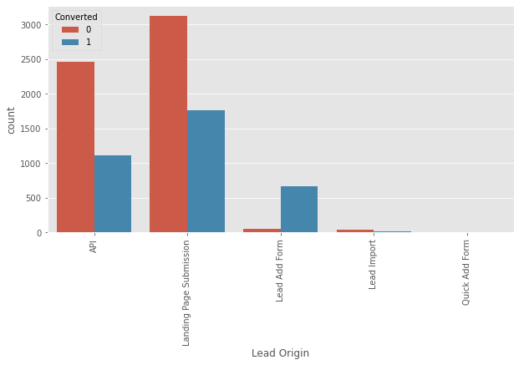
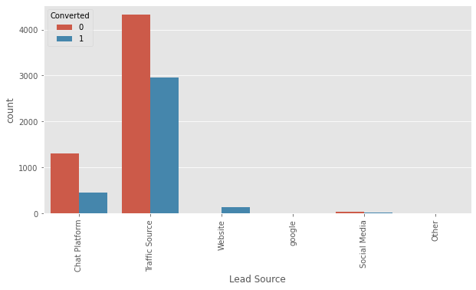
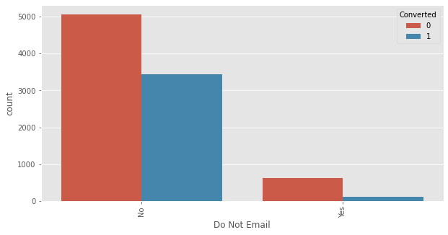
C. Exploratory Data Analysis
Based on Lead Origin column, API and Landing Page Submission bring a higher number of leads as well as conversions. Lead Add Form has a very high conversion rate, but the count of leads is not very high. Lead Import and Quick Add Form get very few leads.
Based on Lead Source column, it is observed that most leads are sourced from chat platforms and traffic sources such as Google, Direct Traffic, Organic Search, Reference, Referral Sites, Bing, Click2call, Pay per Click Ads, welearnblog_Home, WeLearn, blog, and NC_EDM.
Interaction Preference column suggests that about 90% of users prefer not to be contacted via phone or email regarding the product.

Slide 7
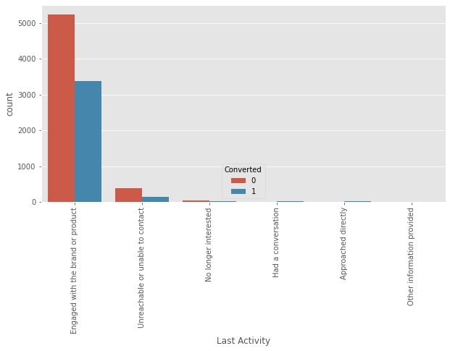
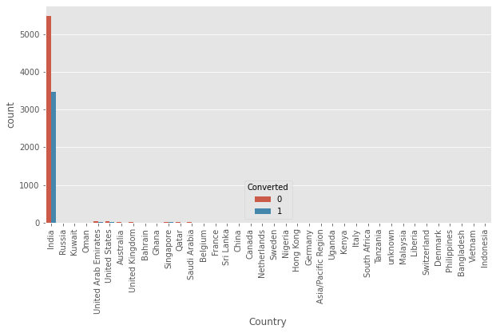
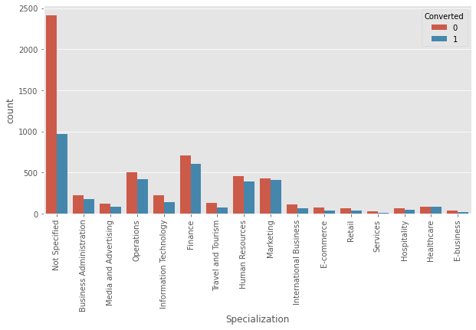
C. Exploratory Data Analysis
Last Activity column analysis indicates that more than 80% of users who have been engaged through activities such as "Email Opened", "SMS Sent", "Resubscribed to emails", "Visited Booth in Tradeshow", "Email Received", "View in browser link Clicked", "Form Submitted on Website", "Olark Chat Conversation", "Page Visited on Website", "Converted to Lead", and "Email Link Clicked" are most likely to get converted.
Country column analysis shows that 90% of the users who got converted and were not converted belong from India, suggesting people from India have a high chance of getting converted.
Specialization column suggests that people enquiring for courses on business management like operations, finance, human resource, market are more likely to get converted.

Slide 8
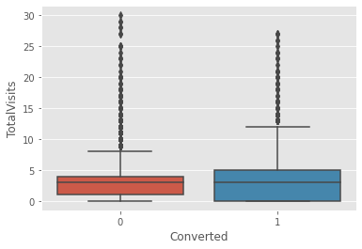
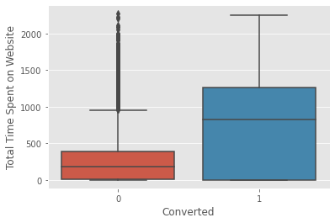
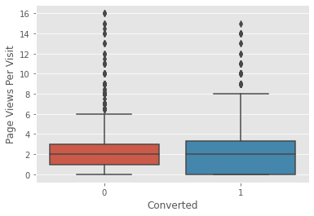
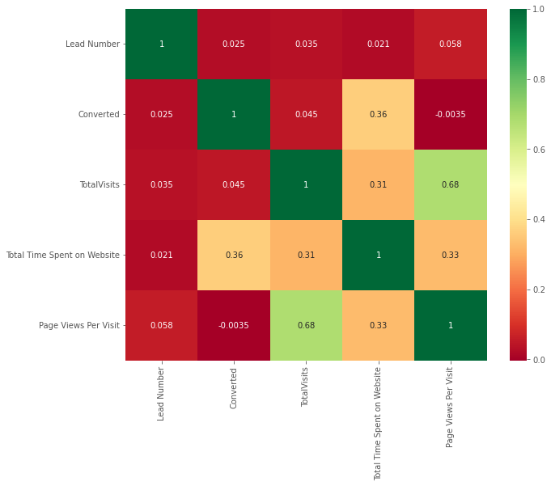
C. Exploratory Data Analysis
Summary:-
The Total Visits and Page View Per Visit columns have a significant number of outliers. However, after removing the outliers, there was a positive change observed in the correlation matrix.
There is a strong relationship between the Total Visits and Page View Per Visit columns.
Individuals who spend more time on the website are more likely to be converted.

Slide 9
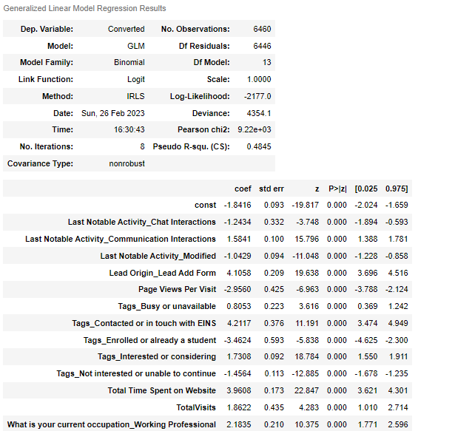
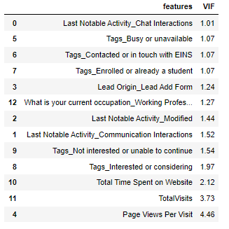
D. Model Training and Assessment – GLM Results

Slide 10
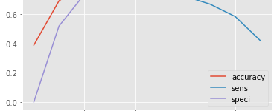
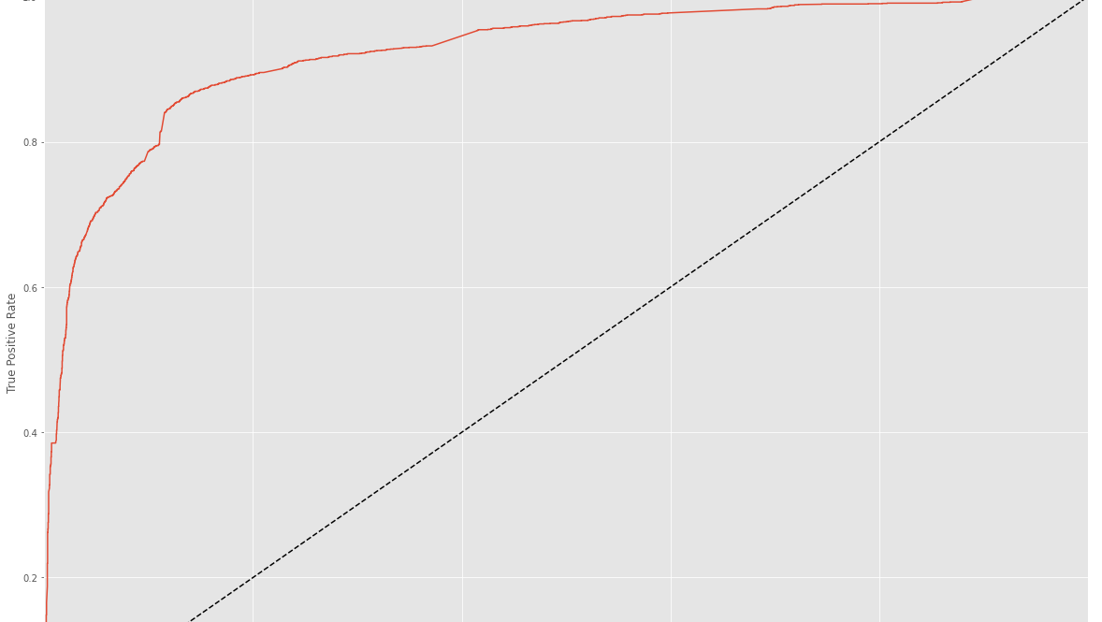
C. Model Training and Assessment – Cutoff Point & ROC Curve
From the curve above, 0.4 is the optimum point to take it as a cutoff probability.
The ROC Curve should be a value close to 1. We are getting a good value of 0.97 indicating a good predictive model.

Slide 11
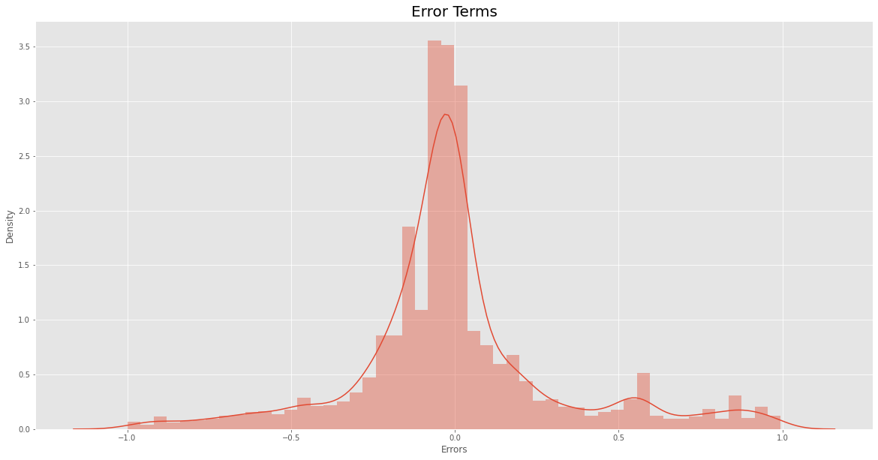
C. Model Training and Assessment – Error Residuals
Error Residual Following Normal Distribution - It indicates that this assumption is met and therefore the model inferences such as confidence intervals and predictions are valid.

Slide 12
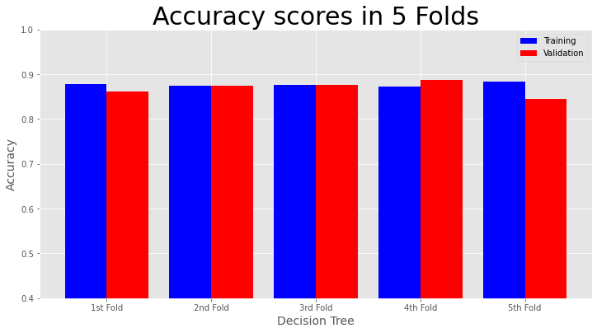
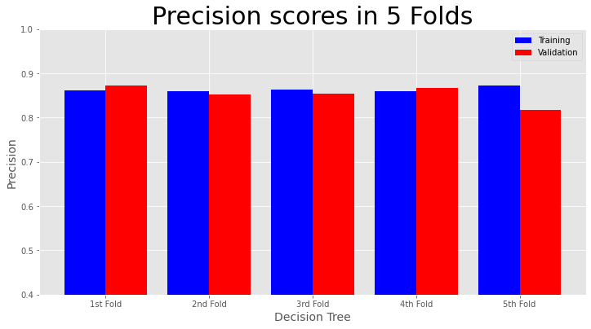
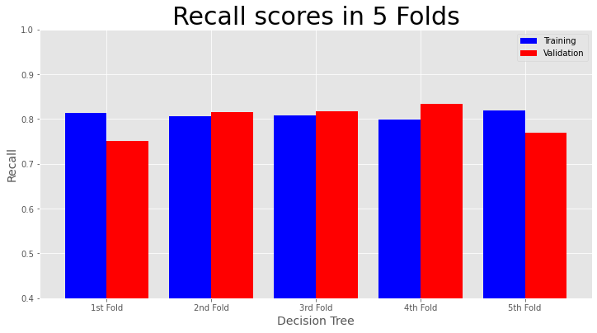
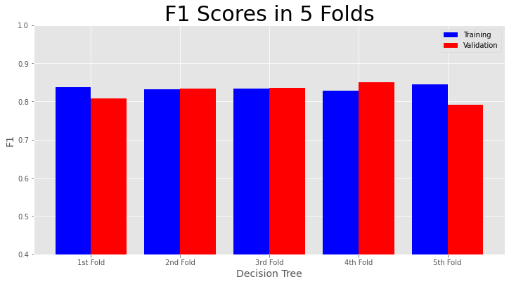
C. Model Training and Assessment – 5-fold cross-validation

Slide 13
Summary
The analysis was conducted using a Logistic model to predict the conversion rate for a company. After running the model on the test data, the following observations were made:
The accuracy for the train data was 83.29% while the sensitivity and specificity were 83.70% and 83.66%, respectively.
The accuracy for the test data was 84.78%, with sensitivity and specificity values of 83.98% and 85.26%, respectively.
To verify the accuracy of the model, 5-fold cross-validation was used to train the model across different combinations of data.
The model performed well in predicting the conversion rate, and the CEO can have confidence in making good decisions based on the model's predictions.

Slide 14

Thank you

